Slide 1


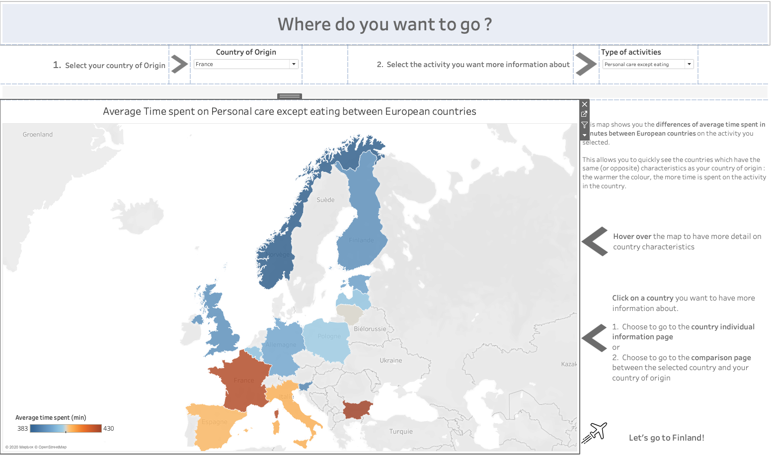
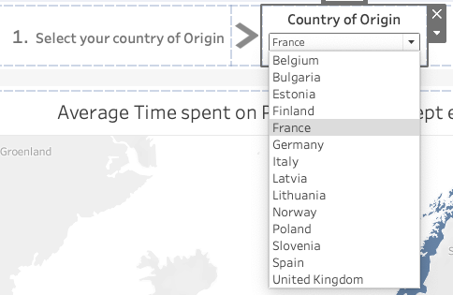
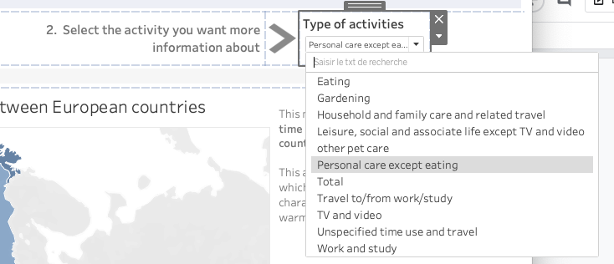
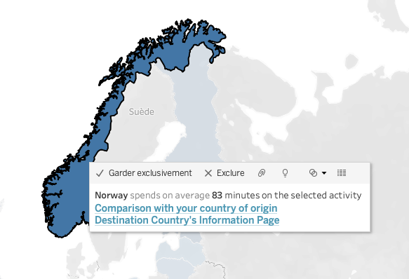
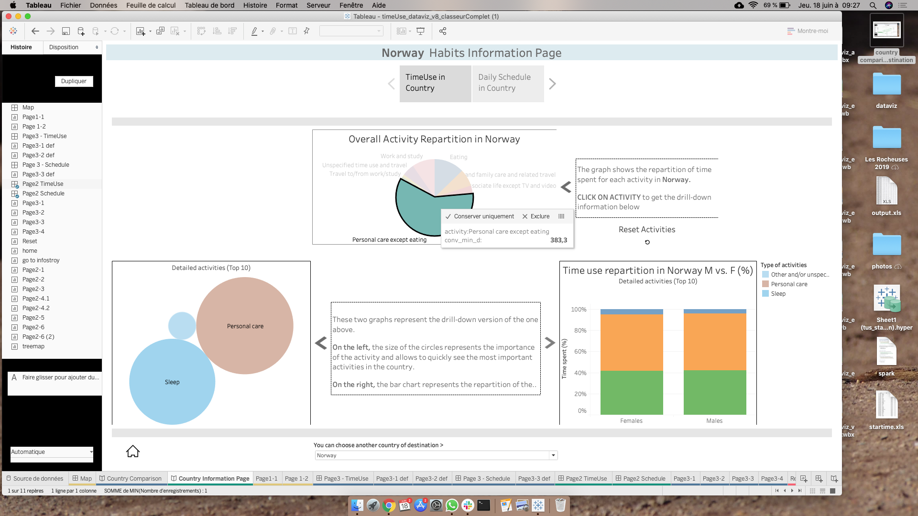
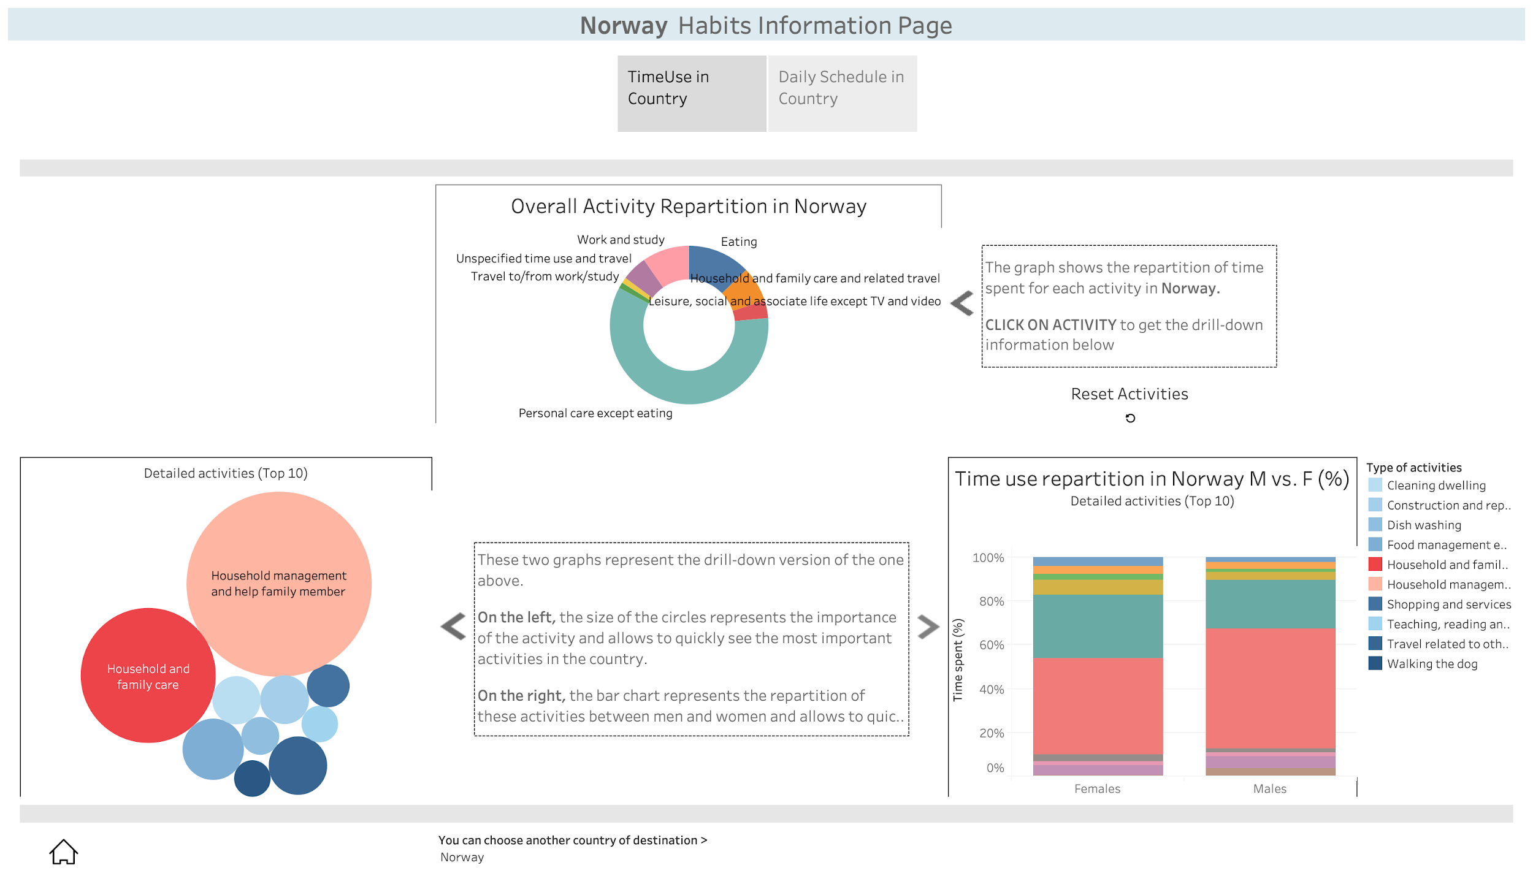
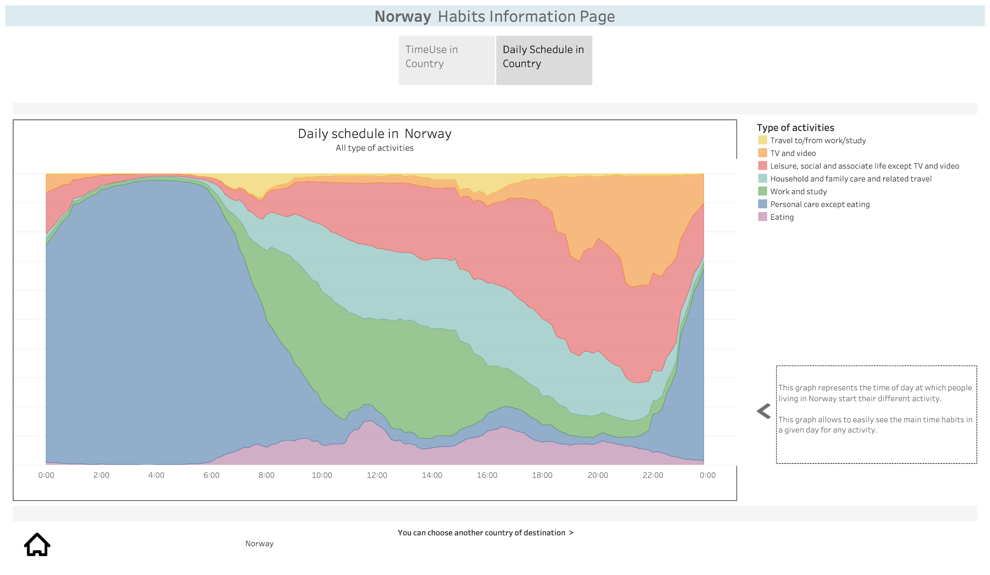

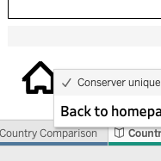
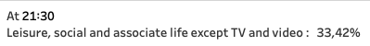
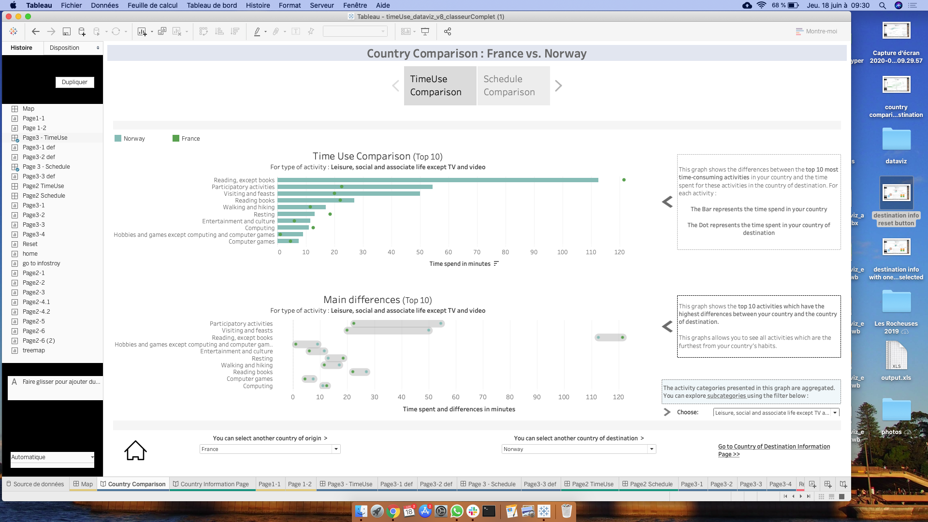
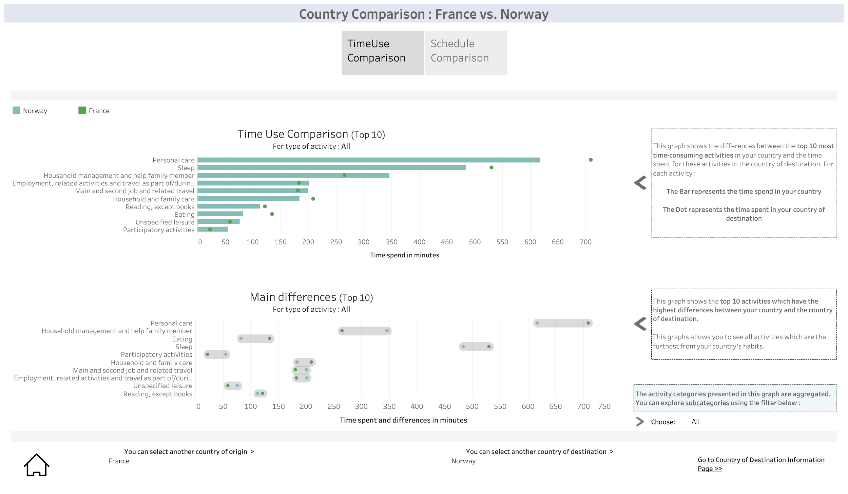
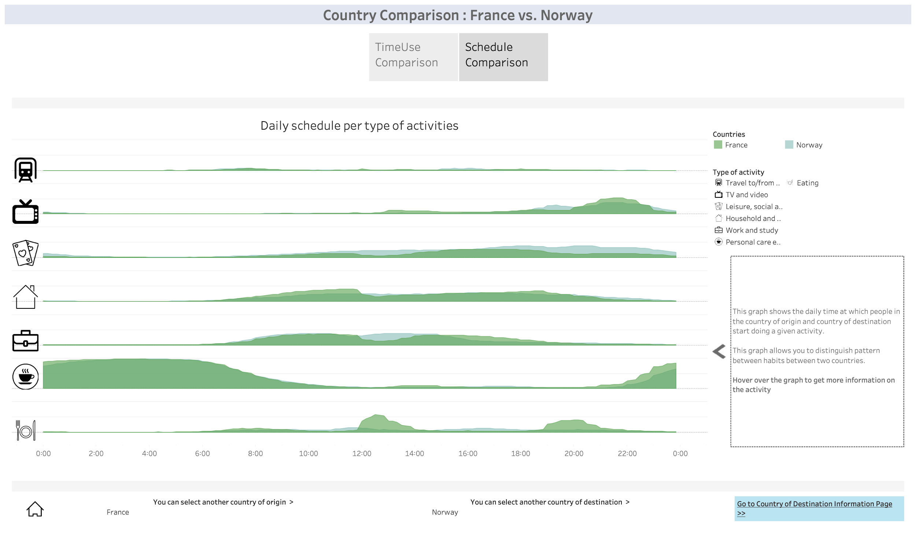
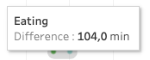
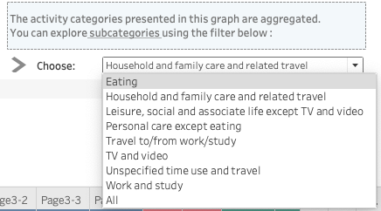
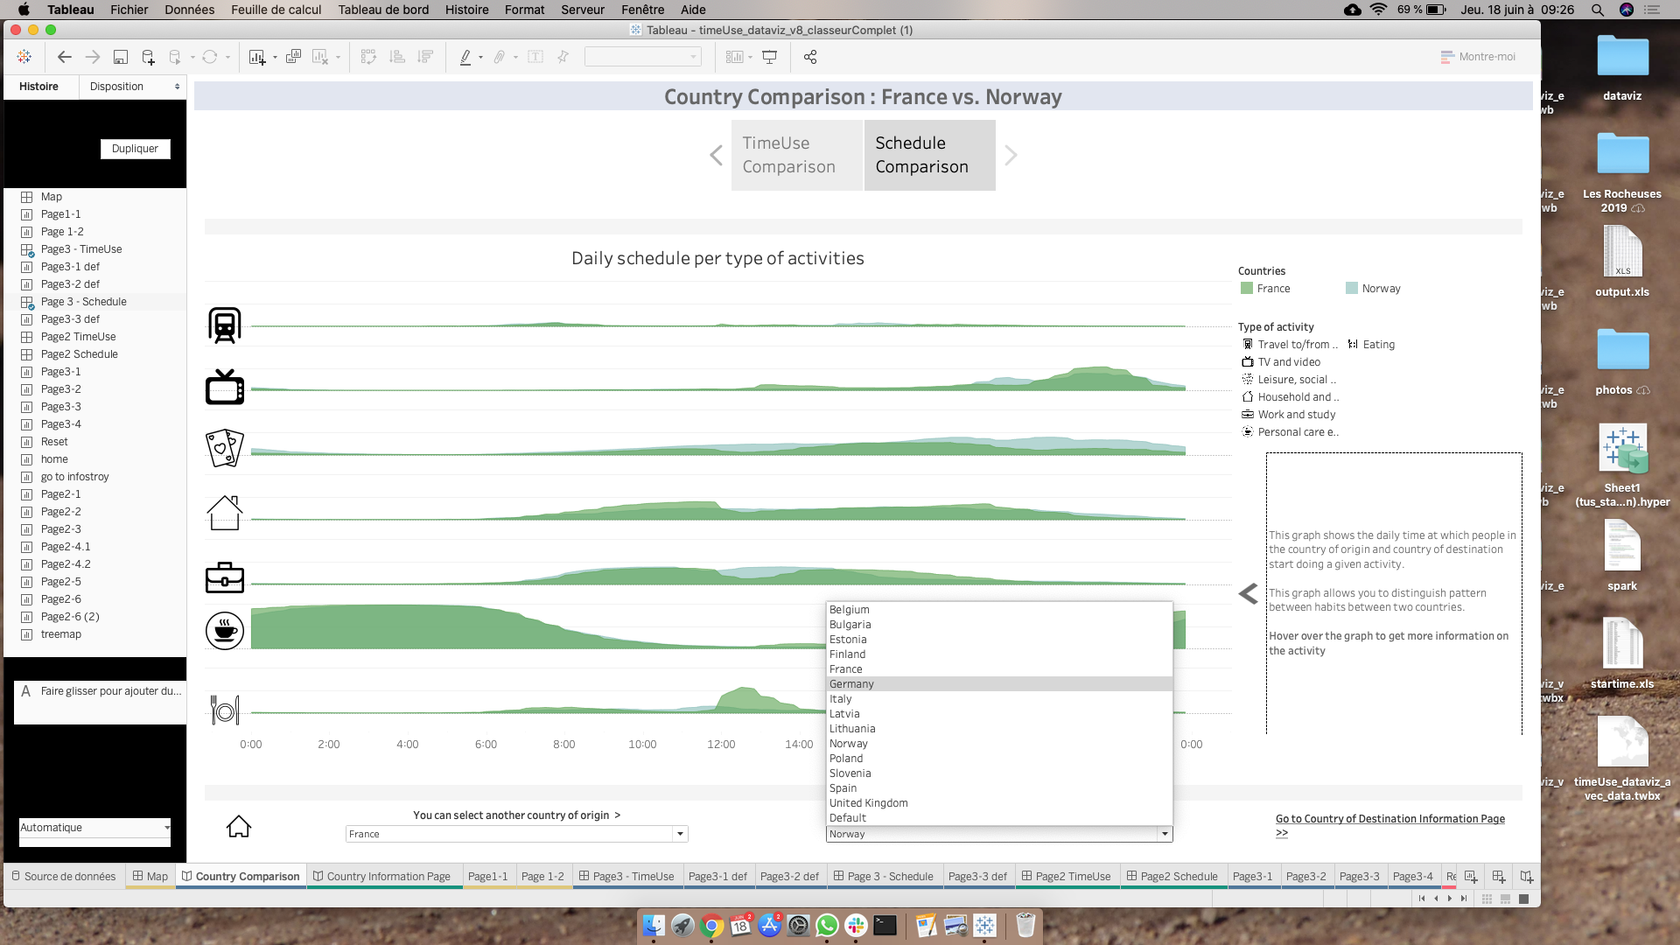
A graphical user interface on European time use
XXX, XXX, XXX, XXX, XXX
Context & Objectives
Materials & Methods
From one European country to another, we do not spend the same amount of time on our daily activities. However, many people travel from one country to another, whether for tourism or for professional reasons. They may wonder : what time to go to restaurant ? is everything closed because people sleep or take a nap at that time ? if flat sharing, what are typical expectations for chores ?
This is why our goal is to build a visualization tool providing people who travel with information on the time use of European countries.
Datasets.
Dashboard.
Both datasets are from Eurostat.
The dashboard built contains three pages in which the user can :
Select a country/activity
Obtain descriptive information on the time use of a country
Compare the time use of two countries
The first one is from the HETUS studies. It considers the average daily time spent for each of the 56 activities considered. It covers 14 European countries, and also allows for a finer representation by gender.
The second considers the same set of countries but adopts a more temporal approach. It indicates what percentage of the population is currently busy running a given activity by slices of 10 minutes.
Technologies.
1
Overview of time use in European countries
Select the country of origin in a drop-down list
Select the activity of interest in a drop-down list as well
Hover over the map to have more details on country characteristics
Select a country to “visit” by clicking on it, which leads to either the country individual information page or the comparison page of the dashboard
This first page shows the differences of average time spent in minutes between European countries on the activity selected. It allows to quickly see the countries which have the same (or opposite) characteristics as the country of origin : the warmer the colour, the more time is spent on the activity in the country.
When hovering
2
Descriptive information on the time use in a country
The second page represents the country identity card. It is composed of two views through which the user can navigate. The first one (1) shows the repartition of the time spent in each activity. The second one (2) shows the daily schedule in the country.
Select an activity on the pie chart to display the repartition of its sub-categories on the two graphs at the bottom
Navigate through the two views via a navigation bar
1
2
Highlight the area of an activity by clicking on it
Tooltip when hovering
After an update
Switch to another country with the drop-down list at the bottom
Reset activities by clicking on the reset button
Return to the first page with the “house” icon in the bottom-left corner
3
Compare the time of use between two countries
The third page allows to compare two countries : for instance, the country of origin vs. the country of destination. It is composed of two views as well. The first one (1) shows the differences in time use for the top 10 most time-consumed activities. The second one (2) shows a schedule comparison.
Select an activity in the drop-down list in the bottom-right corner to update the graphs by displaying the differences for the sub-categories of an activity.
After an update
Navigate through the two views via a navigation bar
1
2
Change the countries of interest or the destination with the drop-down list at the bottom of each view
Tooltip when hovering
Hover the graph to get more information about an activity
After an update
Return to the first page with the “house” icon in the bottom-left corner

